Slide 1
Instructions for programming the Digilent Nexys4 SPI Flash with an FPGA configuration file using Xilinx ISE 14.6
Andrew Read
June 2015

Slide 2
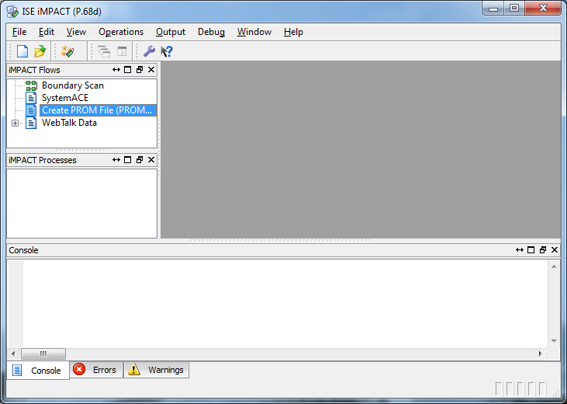
Open iMPACT from the Tools menu within ISE
Double click Create PROM file

Slide 3
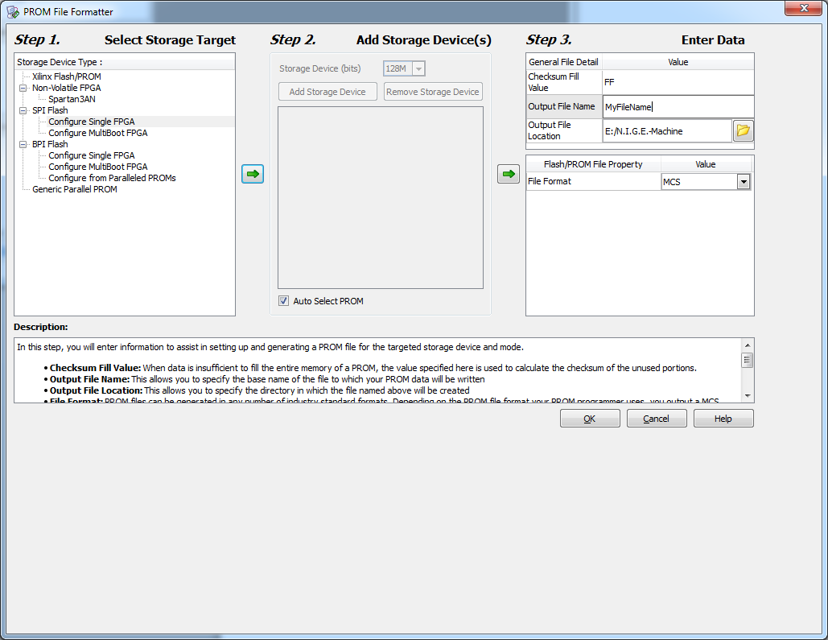
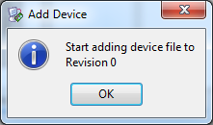
Note settings
Note settings
Output filename
Note settings
Click OK
Click OK

Slide 4
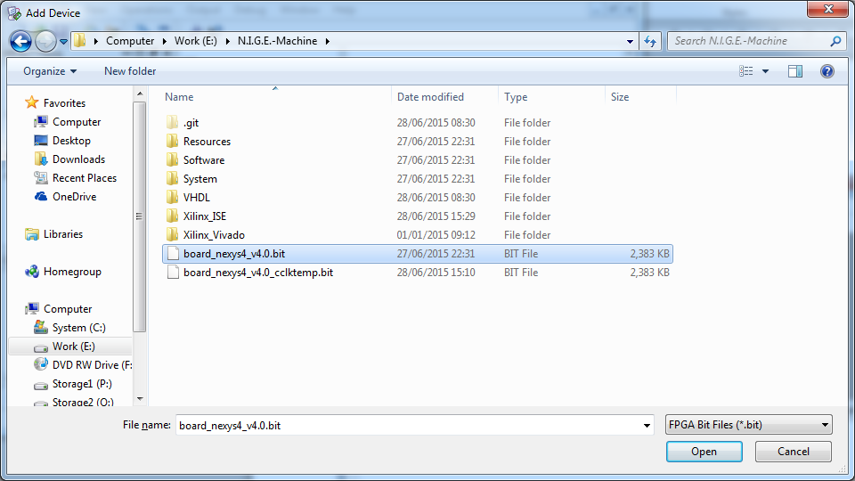
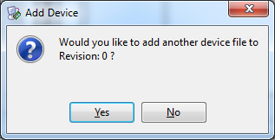
Select an FPGA configuration .bit file created by ISE using Generate Programming File
Click Open
Click No

Slide 5
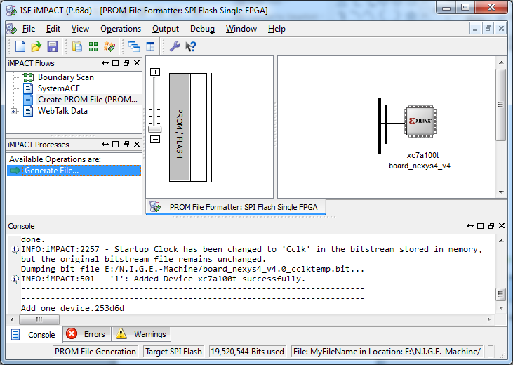
Double click Generate File

Slide 6
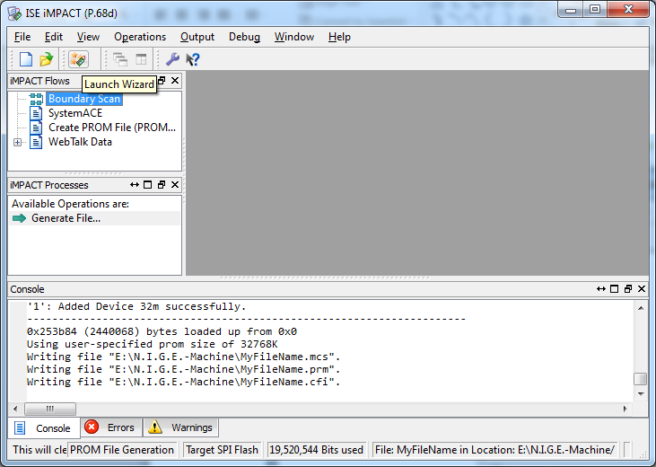
2. Click Launch Wizard
1. Select Boundary Scan

Slide 7
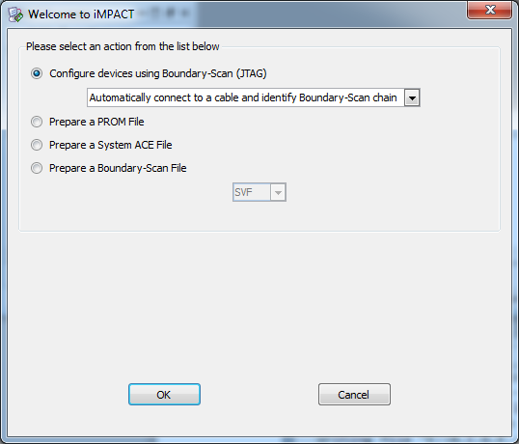
Click OK

Slide 8
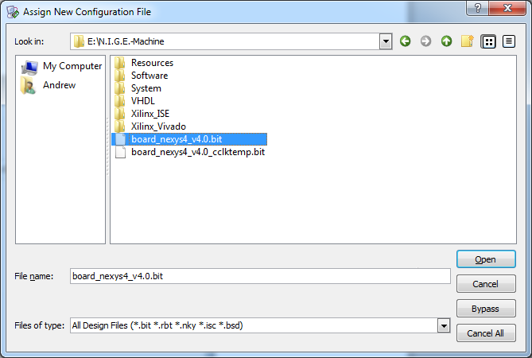
Select an FPGA configuration .bit file created by ISE using Generate Programming File

Slide 9
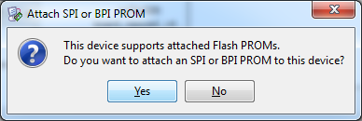
Click Yes

Slide 10
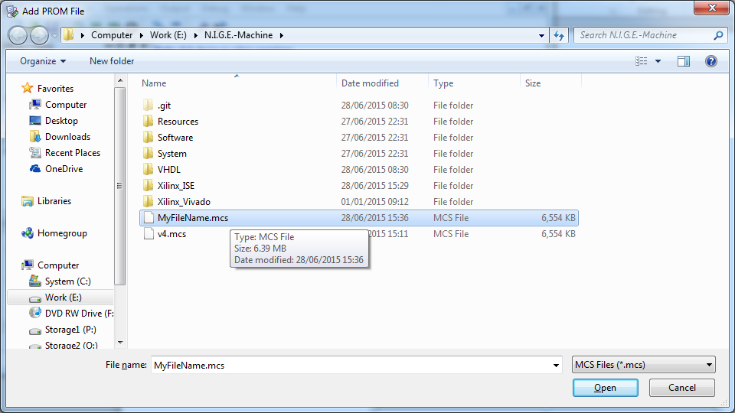
Select the .mcs file created in the previous step

Slide 11
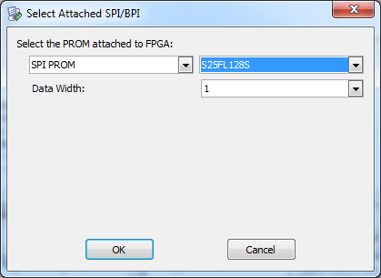
Note settings

Slide 12
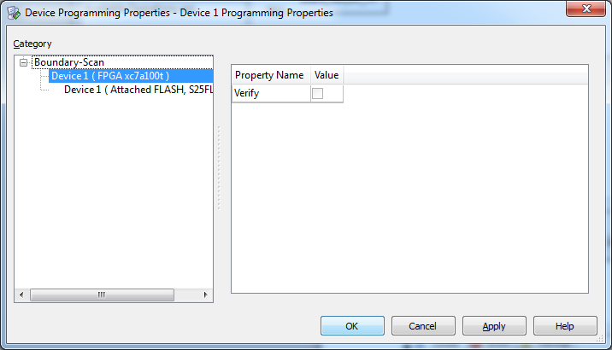
Click OK

Slide 13
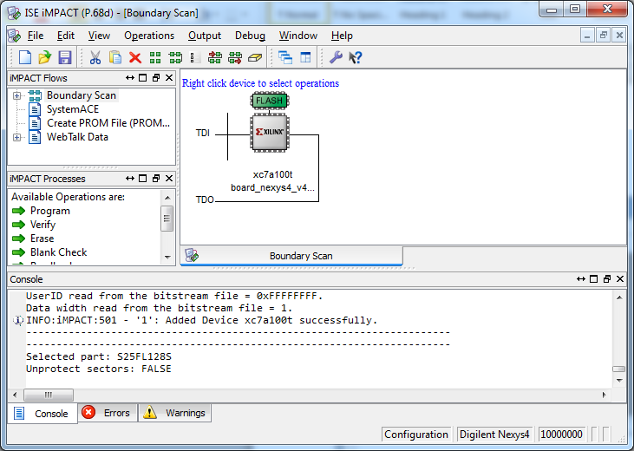
Right click the FLASH icon

Slide 14
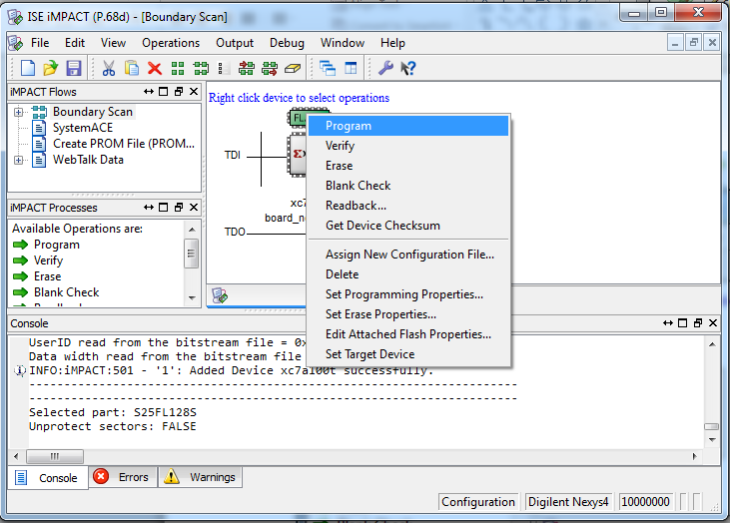
Select Program

Slide 15
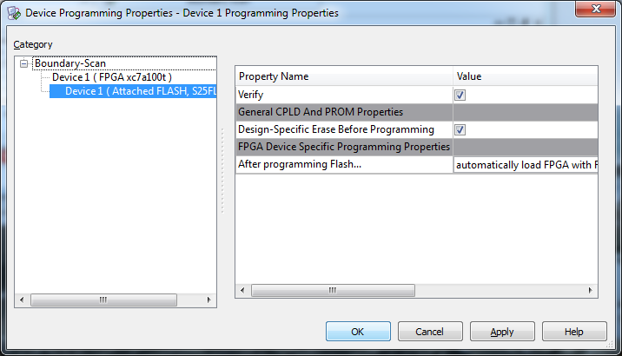
Click OK

Slide 16
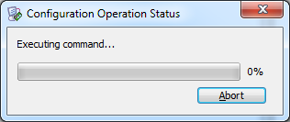
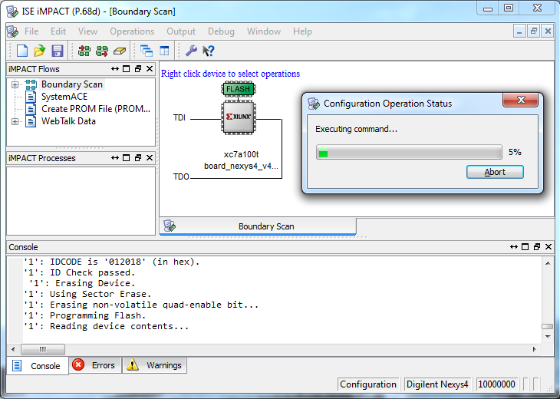
Don’t worry! The progress bar remains on 0% for several minutes initially

Slide 17
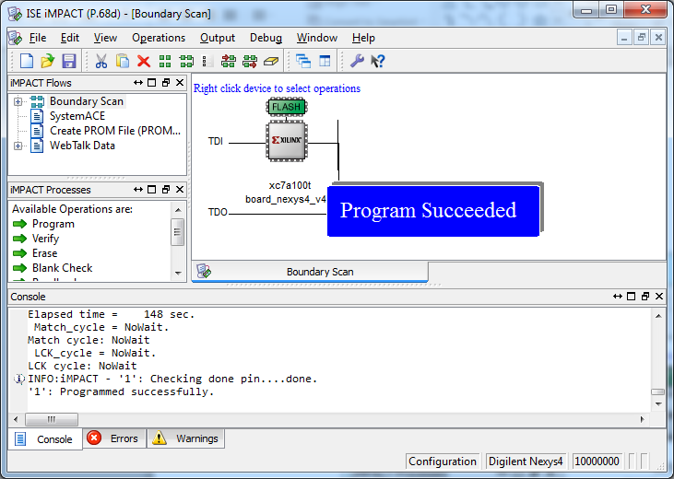
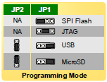
Switch off the Nexys4 board, configure the jumpers for MicroSD, and switch on!

